Slide 1

SOEN 6611 Software Measurement -By Team F

Slide 2
Content
Projects: Overview
Metrics
Metric-wise analysis of projects
Correlation among the metrics
Conclusion

Slide 3
Projects Selected: Overview
S.no | Project Name | Size of the project
1 | Apache Commons Collections | 132K LOC
2 | Apache HttpComponents Client | 70K LOC
3 | JFreeChart | 167K LOC
4 | Apache Commons IO | 33.9K LOC
5 | Apache Commons Configurations | 847K LOC

Slide 4
Metric calculations
Metric 1 Statement coverage: (Number of statements executed/Total number of statements) *100
Metric 2 Branch Coverage: (Number of branches executed/Total number of branches) *100
Metric3: Test Suite Effectiveness Mutation Score: (Number of mutants killed/Total number of mutants) * 100

Slide 5
Metric calculations
Metric 4 McCabe’s Cyclomatic Complexity: measure of linearly independent paths for a program is.
M = E - N + 2P. where, E-Number of edges in the graph N-Number of Nodes in the graph P-Number of connected components.
Metric 5 Maintainability Index: Measures how maintainable the project is. MI = 171 – (5.2 * ln(V) + 0.23 * (G) + 16.2 * ln(LOC)) V = Halstead Volume G = Cyclomatic Complexity LOC = count of source Lines Of Code (SLOC) CM = percent of lines of Comment (optional)
Metric 6 Post Release Defect Density: post-release Defect Density is a quality indicator of a project and considers the number of bugs after a release. Defect Density = Number of known defects (bugs) / SLOC

Slide 6
Metrics
Metric | Name | Based on | Level
Metric 1 | Statement Coverage | The number of statements executed | Class Wise
Metric 2 | Branch Coverage | The number of branches executed | Class Wise
Metric 3 | Test Suite Effectiveness | Mutation score | Package Wise
Metric 4 | Complexity | number of linearly independent paths | Class Wise
Metric 5 | Maintainability Index | Based on halstead volume, cyclomatic complexity, LOC, and commented code | Project Wise
Metric 6 | Post-release defect density | Based on the bugs reported in issue trackers | Version Wise

Slide 7
Metric-Wise Analysis of projects
Project | Size | Code Coverage | Branch Coverage | Mutation Score | Average Complexity | Maintainability Index | Post-release Defect Density (for latest version)
Apache Commons Collections | 132K LOC | 65% | 61% | 43% | 14 | 76.3 | 0.00004789
Apache HttpComponents Client | 70K LOC | 69% | 48% | 53% | 11 | 79.1 | 0.00002627
JFreeChart | 167K LOC | 72% | 46% | 33% | 24 | 81 | 0.00002078
Apache Commons IO | 33.9K LOC | 90% | 80% | 80% | 16 | 74.94 | 0.0008232
Apache Commons Configurations | 847K LOC | 86% | 82% | 80% | 18 | 64.15 | 0.00008942
Note: All the numbers above are rounded-off except for post-release defect density

Slide 8
Correlations: Code coverage and test suite effectiveness (Metric 1,2 & 3)
In the 5 open source projects we have selected, we have noticed that:
“With Higher code coverage, we have achieved a better test suite effectiveness”
Tools used to calculate:
Jacoco (EclEmma) to calculate the statement and branch coverage (Metric 1&2)
PITClipse to perform PIT testing to get the test suite effectiveness (Metric 3)

Slide 9
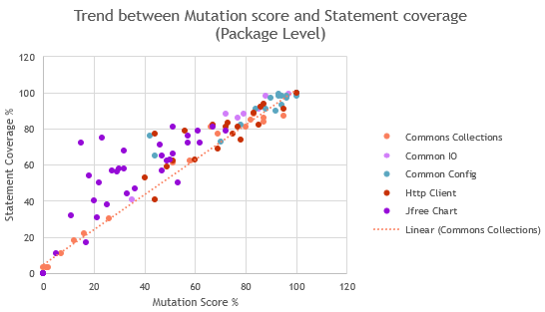
Notes:
https://ieeexplore.ieee.org/stamp/stamp.jsp?arnumber=6527442&tag=1

Slide 10
Spearman Correlation Coefficient
Project | Spearman Correlation Coefficient between Mutation Score and Statement Coverage
Commons Collection | 0.962
Commons IO | 0.958
Commons Configuration | 0.868
JFreeChart | 0.869
Http Client | 0.850

Slide 11
Correlations: Code coverage and code complexity (Metric 1,2 & 4)
“Classes with higher complexity are less likely to have high coverage test suites”
Tools used to calculate:
Jacoco (EclEmma) to calculate the statement and branch coverage and cyclomatic complexity (Metric 1-4)

Slide 12
Correlation between 1-2 & 4
Project | Statement coverage (1) | Branch Coverage (2) | Average Cyclomatic complexity (3) | Spearman Correlation (1&3) | Spearman Correlation (2&3)
Apache Commons Collections | 86% | 49% | 14 | -0.278 | 0.469
Apache HttpComponents Client | 53% | 23% | 10 | 0.0458 | 0.497
JFreeChart | 72% | 35% | 24 | -0.506 | 0.488
Apache Commons IO | 90% | 45% | 16 | -0.400 | -0.0369
Apache Commons Configurations | 91% | 56% | 17 | -0.369 | 0.533

Slide 13
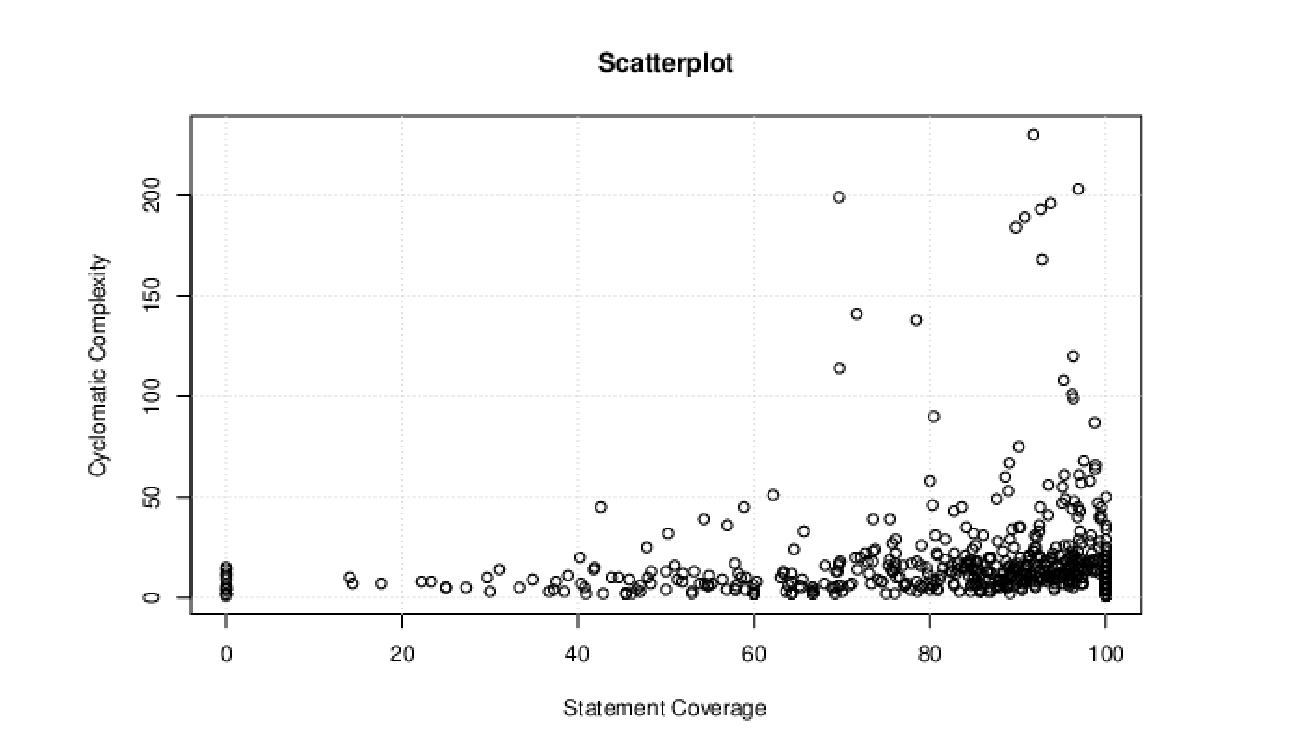
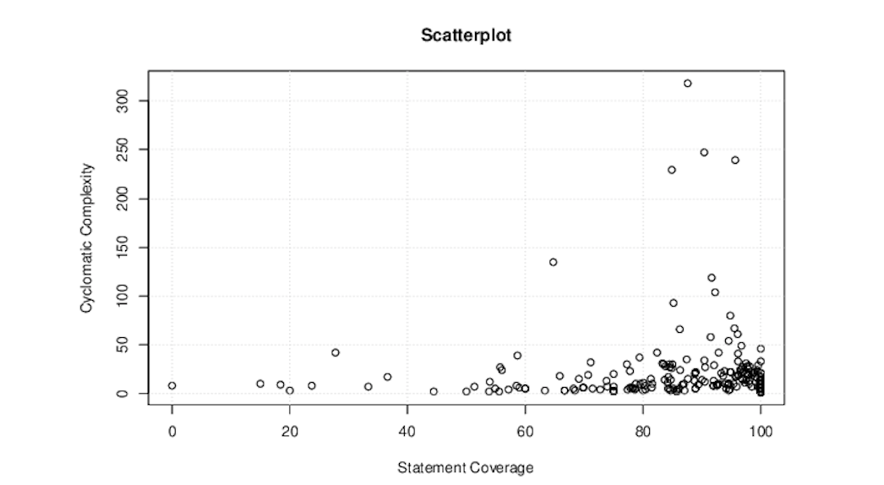
Apache Commons Collections
Apache Commons IO

Slide 14
Correlations: Code coverage and Post-release defect density (Metric 1,2 & 6)
“Classes with low test coverage contain more bugs”.
Tools used to calculate:
Jacoco (EclEmma) to calculate the statement and branch coverage (Metric 1&2)
JIRA and BugZilla as issue trackers to get the bug reports for projects

Slide 15
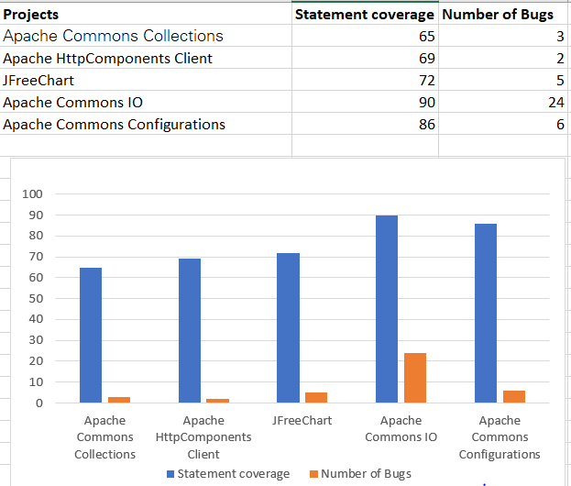
Statement coverage with Post-release defect density
Spearman coefficient
rho= 0.9 (Strong)
Apache Commons IO does not follow the trend as it comparatively a very small project and was released in a very quick succession.

Slide 16
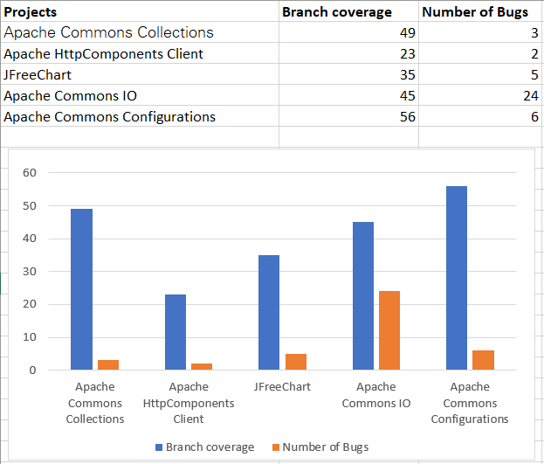
Branch coverage with Post-release defect density
Spearman coefficient
rho= 0.5 (Medium)

Slide 17
Correlations: Maintainability index and Post-release defect density (Metric 5 & 6)
“Higher the maintainability index results in less number of post release defects”
Tools used to calculate:
Use of Prest for Halstead volume and Sci-tools for cyclomatic complexity & SLOC
JIRA and BugZilla as issue trackers to get the bug reports for projects as all the projects use this as their issue tracking system.
We use JIRA and BugZilla GUI for finding the bugs from this issue trackers over all the other ways e.g. Using their API

Slide 18
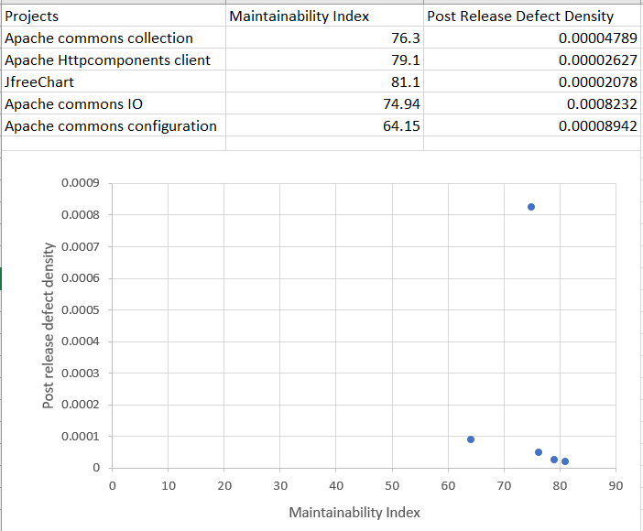
Maintainability index with Post-release defect density
Spearman coefficient
rho= -0.9 (Strong)

Slide 19
Observations
Higher code coverage might not necessarily mean that the project will have less bugs. Instead, coverage ensures there are no/less errors.
Having a better/higher maintainability index ensures less software maintenance costs. However, it might not always ensure a bug free system.
Higher code coverage ensures the efficiency of the project and also has a correlation with complexity. However, the effectiveness of test suite used for coverage has a role to play.
Testing the effectiveness of the test suite largely depends on expertise test professionals, knowledge of the test suite developers as well as the technologies and test automation used.

Slide 20
Thanking you
Submitted By: Group F
Name | Student ID | Email
Sukesh Kumar Mudrakola | 40079835 | sukeshkumar.1995@gmail.com
Pruthvi Raju Nallaparaju | 40076735 | npraju999@gmail.com
Bhavana Bomma | 40071320 | bomma08@gmail.com
Birva Shah | 40070973 | birvashah.shah3@gmail.com
Himani Patel | 40071101 | himanip1996@gmail.com

